Slide 1
Agile@Scale KPI Metrics Brief Overview
V0.0.1
February 2019

Slide 2
How the Metrics Will Be Used
The education is important in the usage and for the success in our KPI Metrics the key message:
The KPI Metrics are to be used to help the teams improve NOT to be used to punish or whip teams.
Tell me how you measure me and I will tell you how I will behave. If you measure me in an illogical way… do not complain about illogical behaviour…
Eli Goldratt
Whenever there is fear, you will get wrong figures.
W. Edwards Deming
The big problems are where people don't realise they have one in the first place.
W. Edwards Deming

Slide 3
KPI Metrics Categories
ROI
These ensure we’re building the right thing from the business point of view. As it currently stands these KPI Metrics are to be defined.
Efficiency
How fast are we going, how much value are we releasing to our customers.
Quality
Are our products stable, are they of the highest quality with minimum cutting of corners to ensure we have sustainable products.
ROI
Quality
Building the right thing
Building the thing right
Building the thing fast
Efficiency
Notes:
Remove the Trello checklist as assumed that guardrails will pick up this part of process

Slide 4
KPI Metrics Categories
Efficiency
When we’re looking at how efficient we are, we need to see where we are improving and where our bottlenecks have moved to. This will help us ensure that we are getting the must from our teams, with as little waste as possible in the flow.
When issues do happen in production, we need to know how efficient we are at getting the service back for our customers so they can start placing bets again.
Lead / Cycle / Flow Times
Deployment Frequency
MTTR (Mean Time To Restore)
Quality
If we optimised only efficiency without ensuring quality we would be doing a disservice to our stakeholders and customers. Every time we push out an update to our products we should be ensuring we’re improving the quality.
When releases happen we want them to happen more often, and for this to work we need to ensure that are releases are small and often with minimal disruptions.
Number of Bugs
Number of Technical Debt
CFR (Change Failure Rate )

Slide 5
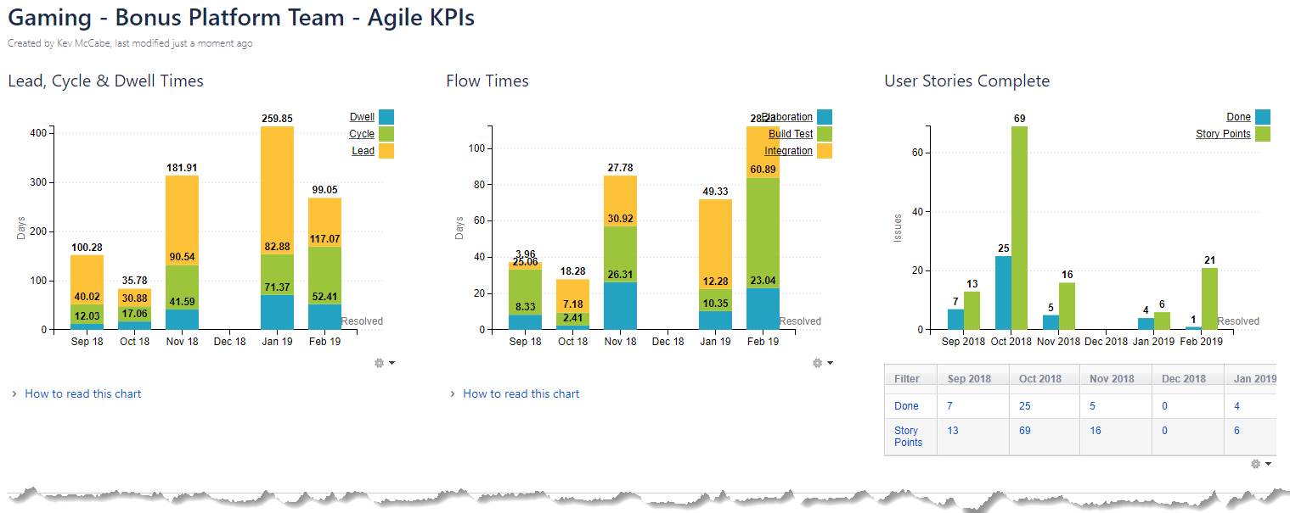
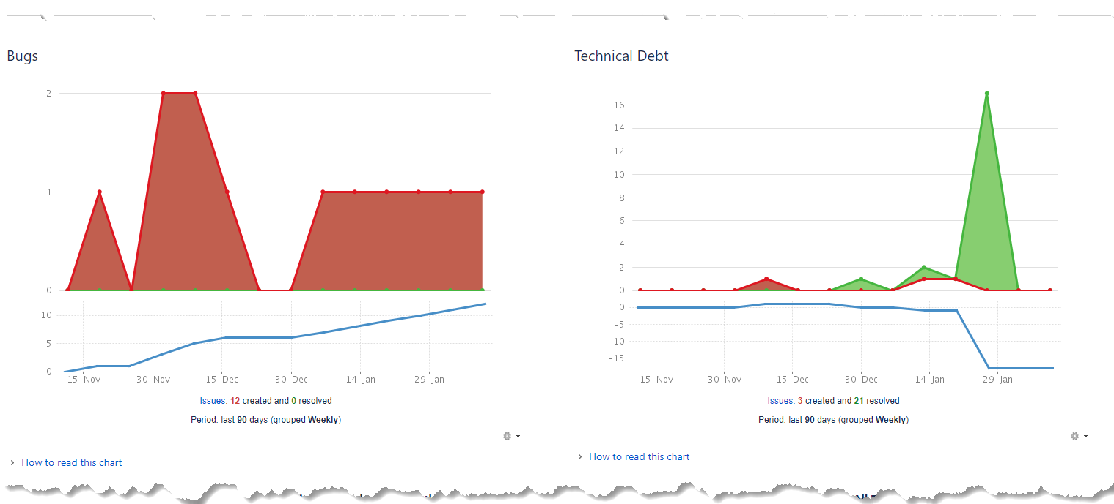
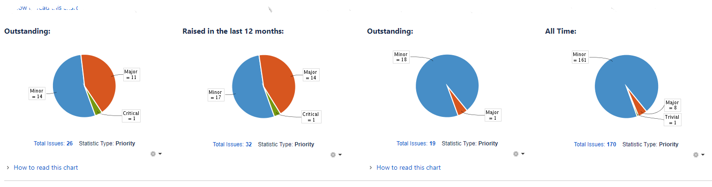
Dashboards

